Slide 1

Undergraduate Implementation of the Viola-Jones Face Detector
Ryan Orf
(Undergrad)
Dept. of Electrical Engineering and Computer Science, University of Missouri,
Columbia, MO 65211, USA
CS 4650/7650, ECE 4655/7655 Digital Image Processing Final Project
Wed Dec 13th , 2021 (3:00-5:00pm)

Slide 2
Outline
Motivation, Scope, and Description
Image Processing Modules and Pipeline
Sample Input and Output Images
Approach: Algorithms and Module Implementation Details
Results: Demo and Evaluation
Walkthrough “Demo”
Summary and Future Work
References

Slide 3
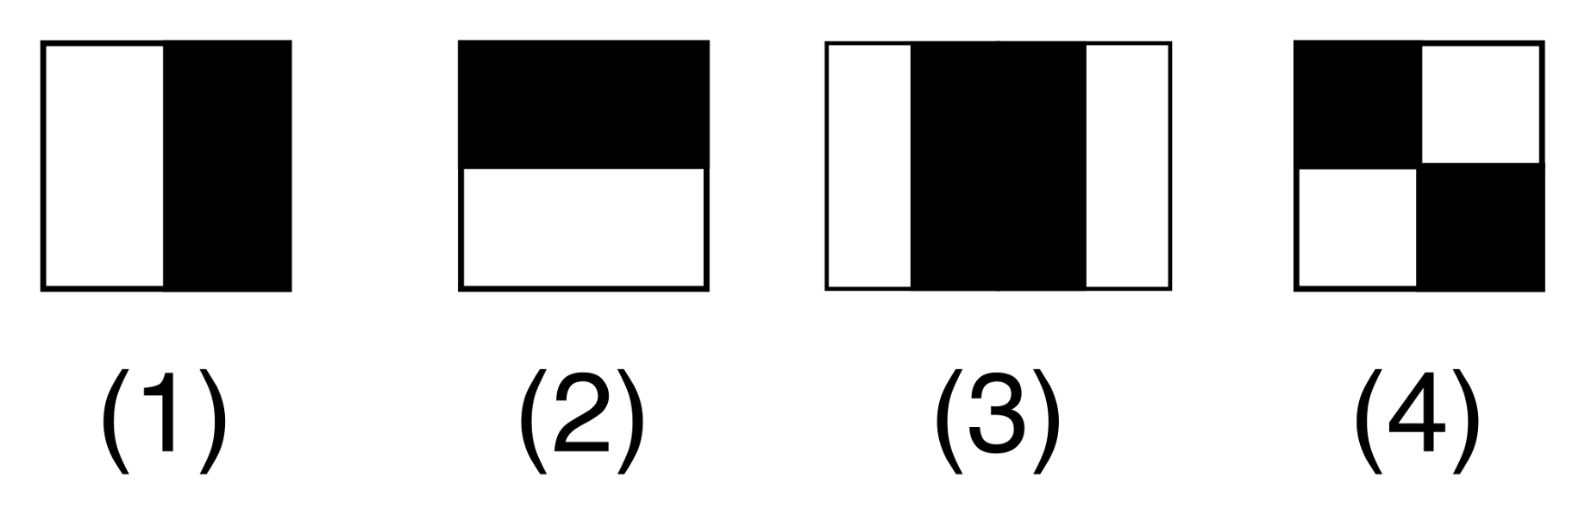
Motivation, Scope, and Description
The Face Detection Problem
Use machine learning to train a predefined dataset of images in order to predict faces in a provided image afterwards
Training process: Convolve each image with Haar features, obtain the ground truth data for the images, and fit the training data to the training test
Motivation
Face Detection is interesting and prevalent in modern society
Useful for entertainment and monitoring, especially criminal
Scope
Basic Face Detection: Find faces within a provided image
Existing Approaches
What is a Haar feature?
Integral Image vs Convolving Haar Features
Many implementations → OpenCV: detectMultiScale()
Uses OpenCV, NumPy, and SciKit
Courtesy of: https://miro.medium.com/max/1838/1*k96yZytRg8FchAcmfw43xA.png

Slide 4
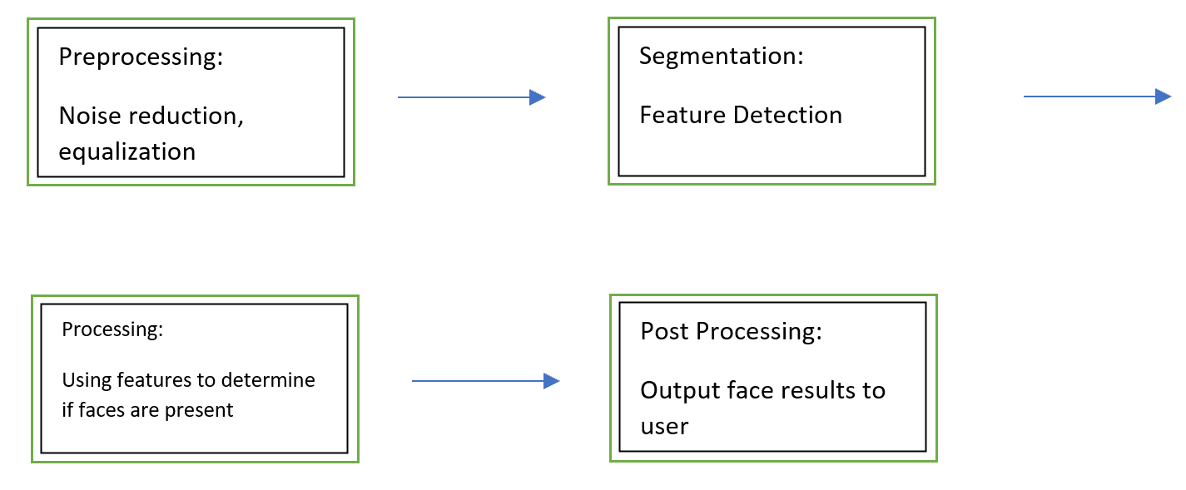
Image Processing Modules and Pipeline
Pipeline:
Implemented Segmentation, Processing, and Post Processing
Segmentation: Made Haar features from sizes 2x2 to 32x32 instead of using an existing set and convolved with each image
Processing: Obtained ground truth images, reshaped data, trained machine, and predicted faces on an input image
Post Processing: Draws red boxes around detected faces
Had to learn about Haar features and MACHINE LEARNING
Modules
Preprocessing: cv2.resize() to reshape images
Segmentation: cv2.filter2D() to convolve Haar feature kernels
Processing: cv2.CascadeClassifier() and .detectMultiScale() for obtaining ground truth data, sklearn.svm.SVC and .fit for training, and .predict for predicting
Used throughout: various numpy and cv2 functions for arrays and image file manipulation

Slide 5

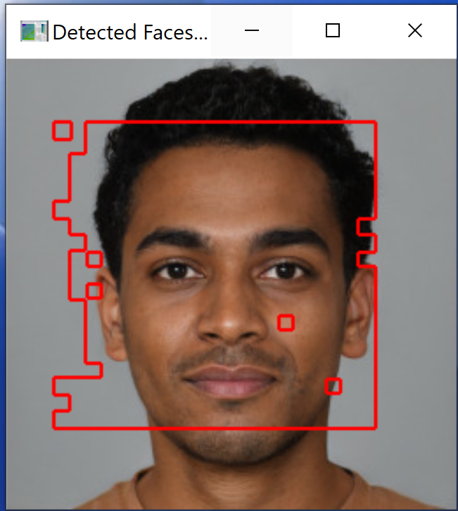
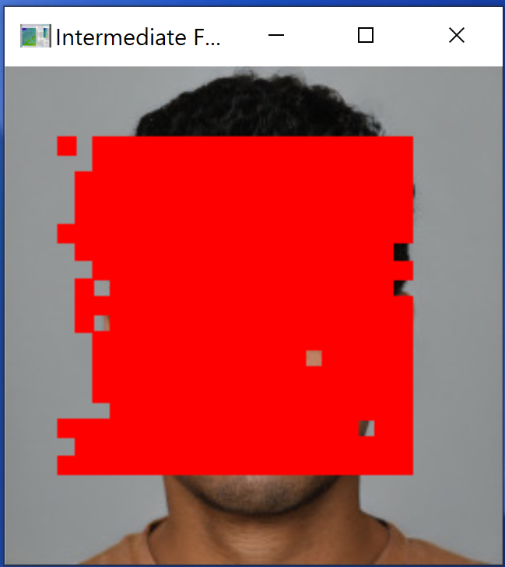
Sample Input and Output Images
Input Image:
Output Image:
Intermediate Image:

Slide 6
Approach: Algorithms and Module Implementation Details
Program Process/ “Pseudocode”
Declare and initialize Haar feature kernels → read in each grayscale image, scale down to 11%, set size of training data and target arrays → loop through images, convolve each Haar feature with image → obtain ground truth data and create array corresponding to whether pixel location is a face or not → loop through each pixel in each image and assign features and ground truth information into appropriate training data and target arrays → train → open and scale down user-provided image → convolve with kernels → properly initialize prediction image → predict faces using machine learning → color faces in red → draw red boxes around detected faces/colored-in areas → display to user
As stated in Modules, used OpenCV’s cv2, NumPy, and SciKit’s sklearn
Dataset: Nine random images of forward-facing faces online
Complexity: O(n^3) or O(n*n^2), where n = features, n^2 = samples

Slide 7
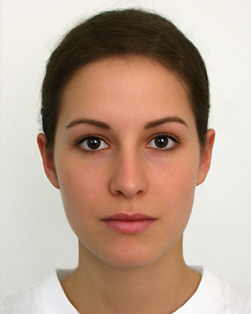
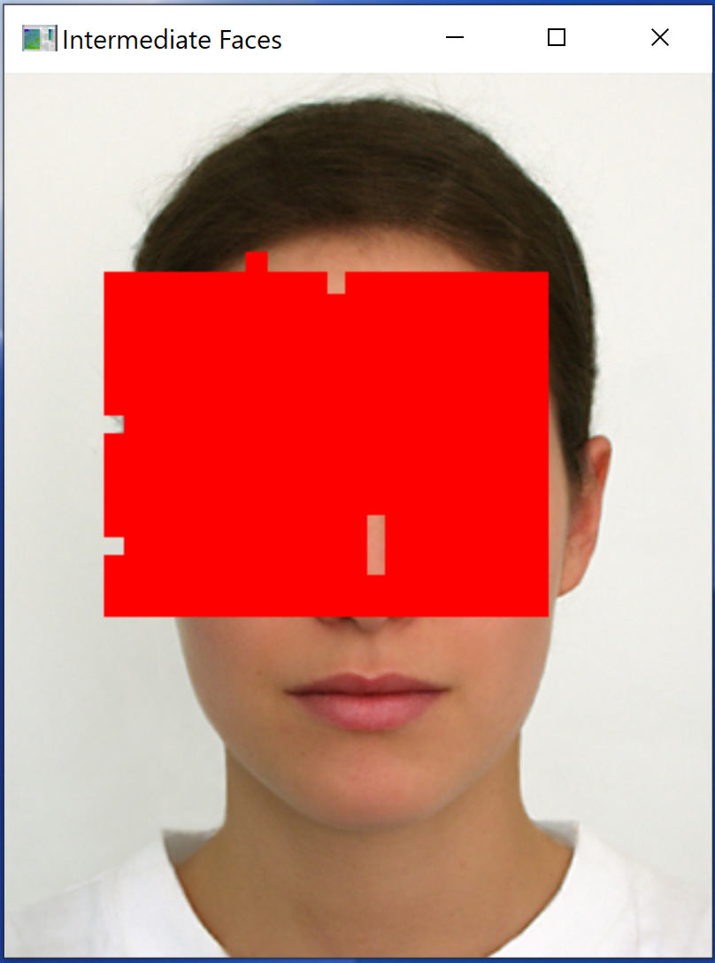
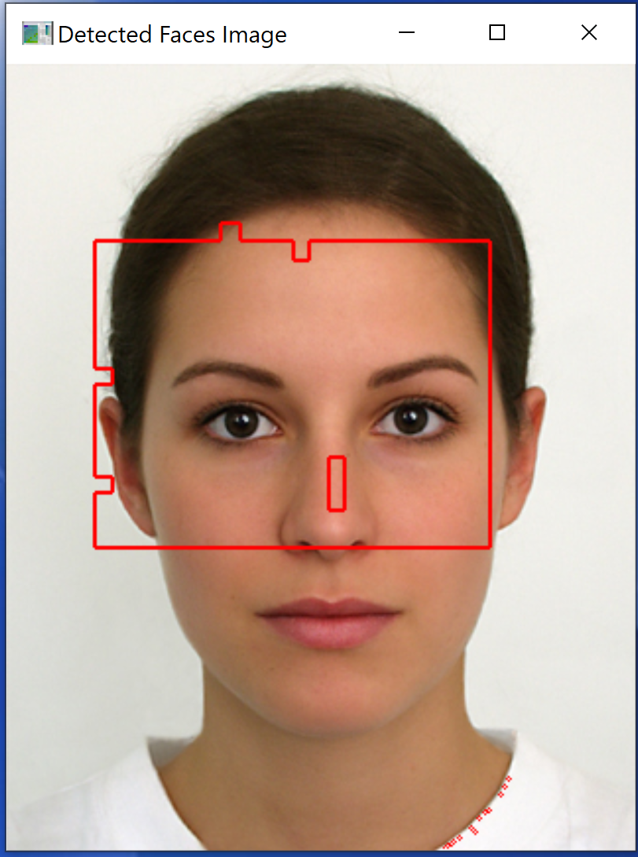
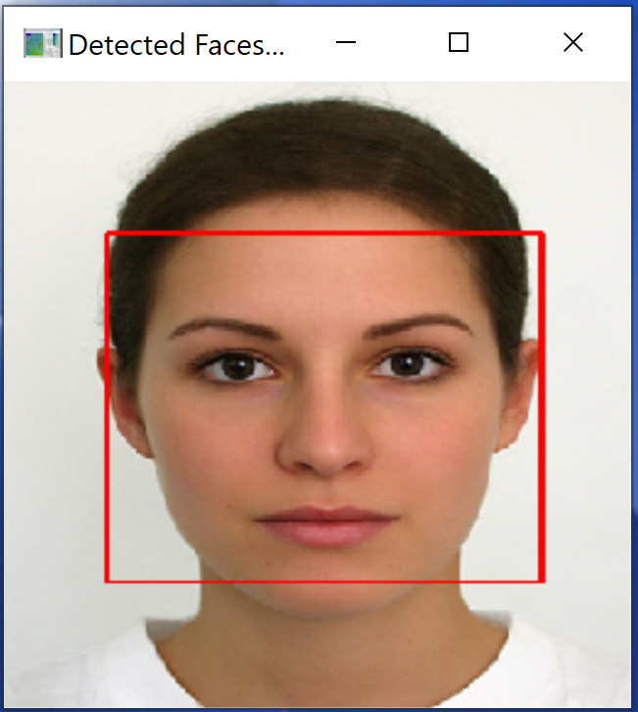
Results: Demo & Evaluation
Input Image:
Intermediate Image:
Output Image:
Built-in Library Output:
As you can see, the program does detect a face
However, results could be better. To the right is the same image with the results obtained from using OpenCV’s cv2.CascadeClassifier.detectMultiScale()

Slide 8
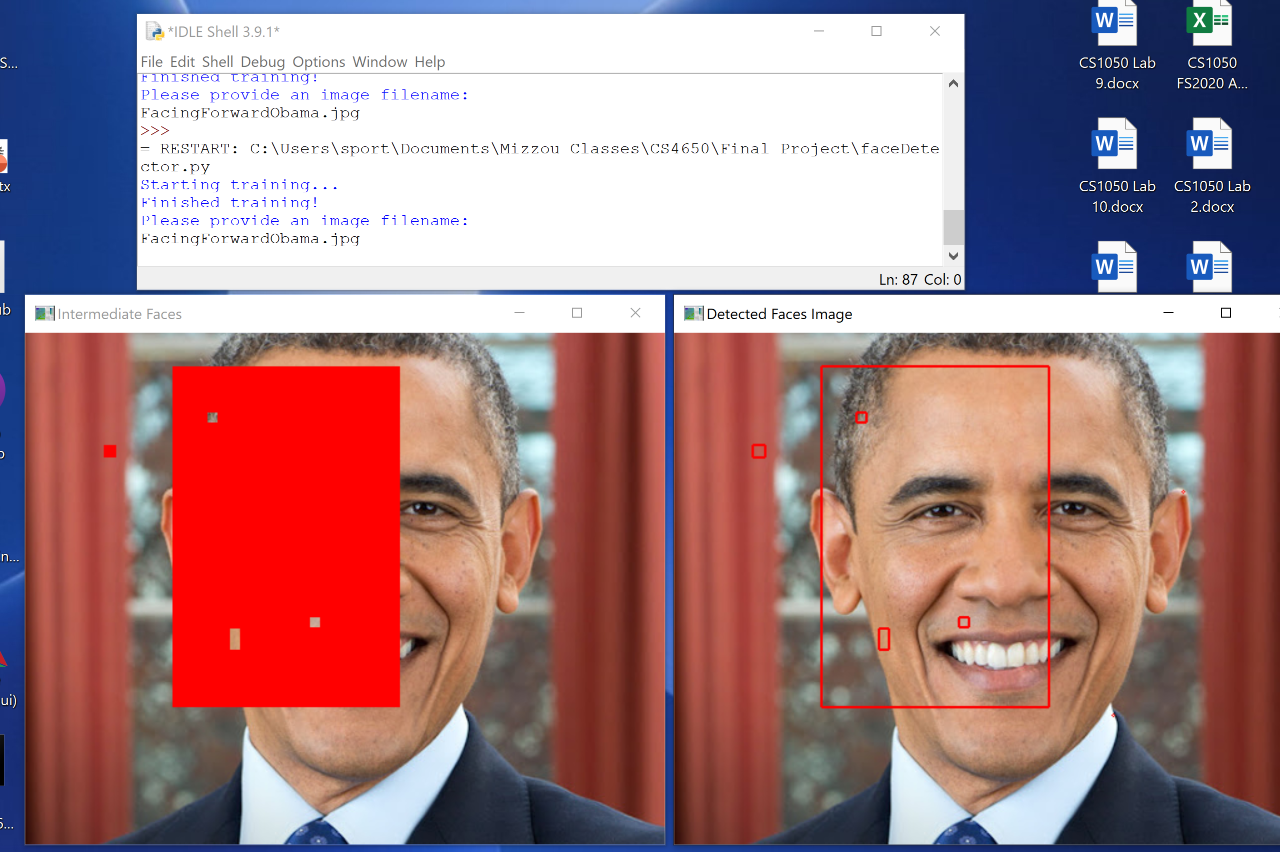
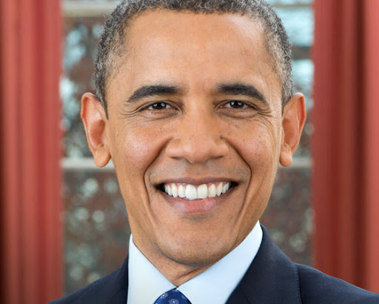
Walkthrough “Demo”
Input Image:
Running Program:

Slide 9
Summary & Future Work
Expectations vs. Reality
Expected: Implement an accurate (~90%) face detector that will work on any image
Reality: Program correctly detects trained faces facing forward, not >= 90% accurate
Problems encountered
Scikit’s sklearn.svm.SVC() for machine learning training and predicting
Large complexity = slow runtime (>6 hours for non-resized images)
Resizing of images = decreased accuracy in Processing and Post Processing
Lessons learned
Machine learning requires lots of data to be accurate and is not easy to understand
Techniques to Improve Upon Code:
Different machine learning implementation (PyTorch, etc.)
Integral Image

Slide 10
References
Lee, S. (2021, August 11). Understanding face detection with the viola-jones object detection framework. Medium. Retrieved December 13, 2021, from https://towardsdatascience.com/understanding-face-detection-with-the- viola-jones- object-detection-framework-c55cc2a9da14.
Zafeiriou, Stefanos, Cha Zhang, and Zhengyou Zhang. "A survey on face detection in the wild: past, present and future." Computer Vision and Image Understanding 138 (2015): 1-24, --- 449 citations.

